Slide 1
Basics of functions in bash scripts

Slide 2
What Is A Function?
A set of commands which users can call repeatedly is known as a Bash function.
The functions help in making a Bash script readable and avoid writing repetitive codes.
They can return a value in one of the following ways:
Change a single or multiple variable's states.
Make use of the exit command to end the script.
Can be used to update the contents of a file.
Can use the return command for ending the function, and the supplied value is returned to the calling section of the script.

Slide 3
How To Define A Function?
The preferred and widely used format is the one that starts with a function name and then followed by a parenthesis.
function_name () {
Commands
}
Single line version of the above format is:
function_name () { commands; }

Slide 4
How to define a function?
The second format uses the reserved word “function” to start, and then it is followed by the function name.
function function_name {
commands
}
Single line version of the above format is:
function function_name { commands; }

Slide 5
Key points to note when defining a function
The commands inside the {} are also known as the body of the function. You must ensure to separate the curly braces from the body by using new lines or spaces.
In Bash, if you define a function, it doesn't mean that it will get executed automatically. It would be best if you used the function name to invoke a function in Bash script. When you invoke a function, the body of the function will get executed.
You must define the function before placing any calls to the function.
The compacted function or the single line versions must have a semicolon after the function's last command.
It is prudent to keep the function names descriptive, in line with the code.

Slide 6
example of a function
In line 2, we will define the function by assigning it a name (example_git). The { will mark the beginning of the function’s body.
Line 3 represents the function body. It can contain multiple variable declarations, statements, and commands.
The } in line number 4 is defining the end of the example_git function.
We are executing the function in line number 5. You can execute the function any number of times you want.
When you run the script, it will display the message 'hello, this is GIT Bash!’
#!/bin/bash
example_git () {
echo 'hello, this is GIT Bash!'
}
example_git

Slide 7
Built-In Functions And Shell Script Function Libraries.
Bash allows you to create function files that will store all your functions.
These function files are called function libraries.
Then you can load all your functions into the Bash script.
The syntax to load all functions is as follows:
. /path/to/your/functions.sh

Slide 8
How to call a function?
You must define the function in the script before making any calls to the function.
To invoke or call a function, type the function name.
You can call or trigger a function in a Bash script by invoking its name in the script.
Bash treats the function calls as a command.

Slide 9
Example showing how to call a function
The example shows how to define and write a function called tomrw() to display tomorrow’s date.
tomrw(){ date ++date=’1 day after’;}
To call the function tomrw(), you will need to write:
tomrw
Your program will look like this in the end:
#!/bin/bash
tomrw(){
date ++date=’1 day after’;
}
tomrw

Slide 10
How To Return Values?
The Bash function will return the exit status for the last command it executes, captured in the $? variable.
All non-zero positive integers between the range 1-255 will indicate a failure, and zero will indicate a successful execution.
However, users can put a return statement inside the script for altering the function's exit status.

Slide 11
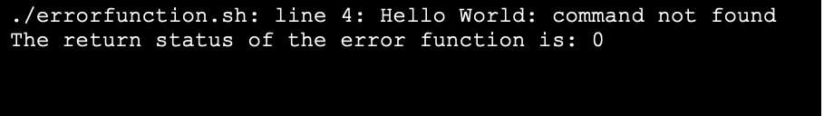
example and output
#! /bin/bash
error_script ()
{Hello World
return 0
}
error_script
echo "The return status of the error function is: $?"

Slide 12
What Is An Attribute Or Parameter?
Bash uses entities known as parameters to store values. It can either be a name, number, or unique character.
The parameter which is denoted by a name is also called a variable.
The variable includes a value and zero or more attributes. You can assign the attributes with the builtin declare command.
There are two types of parameters:
Positional parameters: Denoted by one or more digits, in addition to the single digit 0. You can assign positional parameters by invoking Shell's arguments and reassign them using the builtin set command. They are the arguments given to the Bash script when it is invoked. They can range from $1 to $N. If N consists of more than one digit, you must enclose it in braces like ${N}.
Special parameters: Those which the Shell treats specially. ($*), ($@), ($#), ($?), ($$), etc are the examples of special parameters in Bash.

Slide 13
global and local variables
#!/bin/bash
pprint()
{
local locvar="Local variable"
echo -e "Value of the Local variable within the function"
echo $locvar
glovar="Global variable changed"
echo -e "Value of the Global variable within the function"
echo $glovar
}
glovar="Global variable"
echo -e "Value of the Global variable before calling function"
echo $glovar
echo -e "Value of the Local variable before calling function"
echo $locvar
pprint
echo -e "Value of the Global variable after calling function"
echo $glovar
echo -e "Value of the Local variable after calling function"
echo $locvar
Global: Some variables which will be available throughout the script.
Local: Only visible within the block of the code.

Slide 14
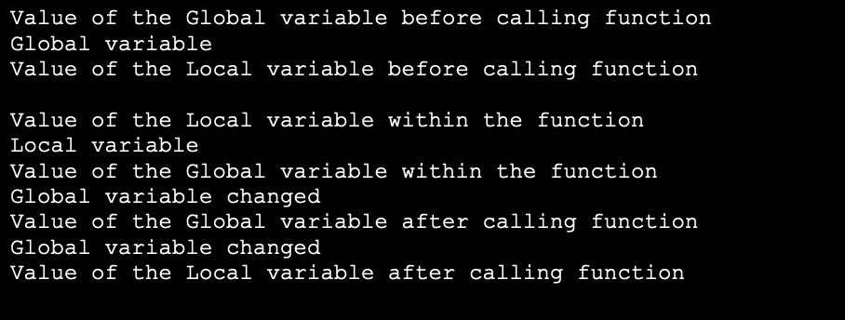
global and local variables
It is clear from the output that:
Before and after calling the pprint() function, the local variables have only empty values. Its scope is limited to only within the function and it gets vanished outside the function.
However, the global variable updates its value even after execution of the function.

Slide 15
Recursion
It is the feature that will allow the user to call the function recursively.
Recursion means the function will call itself to reach an answer.
Mostly, there is a base value to which the recursive function iterates down.
The classic example of recursion is calculating factorials.
The factorial of 5 will be given as:
5!= 5 * 4 * 3 * 2 *1 = 120
We can reduce the above equation to the following format using recursion:
x! = x * (x-1)!

Slide 16
Recursion example
You must define a base case to begin a recursive function. It becomes necessary for ending the chain of calls to the recursive function.
In the factorial_num() function, we have defined the base case as follows:
if [$1 –eq 1]
then echo 1
The next step is deriving the recursive case of the factorial function. As seen above, to find the factorial of a given positive number greater than 1, x, multiply it with the factorial of x-1.
factorial(x) = x * factorial(x-1)
Hence, you can derive the recursive case of the script as:
local var=$(( $1 - 1 ))
local res=$(factorial_num $var)
echo $(( $res * $1 ))
#!/bin/bash
factorial_num() {
if [ $1 -eq 1 ]
then echo 1
else local var=$(( $1 - 1 ))
local res=$(factorial_num $var)
echo $(( $res * $1 )) fi }
read -p "Enter a number: "
input factorial=$(factorial_num $input)
echo "The factorial of $input is: $factorial"

Slide 17
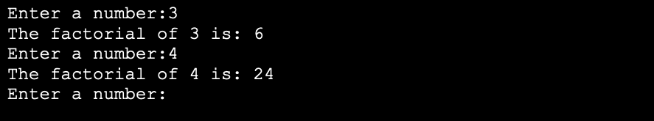
output

Slide 18
Common Errors With Declaring And Using Functions
Bash does not need you to declare a variable. When you use a variable inside the script, it will create a variable automatically. Although it is more convenient, it may lead to unfortunate consequences. An example is a spelling error that may create an extra variable you did not wish to create.
Other common errors include:
Not using the proper syntax to define a function.
The function call has a different function than the one you defined.
Other syntax errors like space between function name and {, case sensitivity, forgot to use “, etc.

Slide 19
summary
This chapter has provided students with the basic knowledge about functions in Bash script.
We covered the definition of a function, different types of functions, syntax, how to call a function, what is recursion, attributes and parameters.
We also discussed some common mistakes which students can make when writing a program containing functions.
Thus, students have the requisite knowledge to start creating Bash scripts with functions. We will discuss the advanced examples on functions in the next chapter.

